Slide 1
2 SAMUEL

Slide 2
2 SAMUEL

Slide 3
2 SAMUEL
1 Samuel ~ Saul
2 Samuel ~ David

Slide 4
2 SAMUEL
I. David reigns over Judah
Chapters 1-4
II. David reigns over a united Israel
Chapters 5-10
III. David’s sin
Chapters 11-14
IV. David threatened by civil war
Chapters 15-20
IV. Appendices
Chapters 21-24

Slide 5
2 SAMUEL
David
Joab
Asahel
Abner
Ishbosheth
David Reigns over Isael (1-4)

Slide 6
2 SAMUEL
¹² Blessed is the man who endures temptation; for when he has been approved, he will receive the crown of life which the Lord has promised to those who love Him. ¹³ Let no one say when he is tempted, “I am tempted by God”; for God cannot be tempted by evil, nor does He
Himself tempt anyone. ¹⁴ But each one is tempted when he is drawn away by his own desires and enticed. ¹⁵ Then, when desire has conceived, it gives birth to sin; and sin, when it is full-grown, brings forth death.
¹⁶ Do not be deceived, my beloved brethren.
James 1.12-16

Slide 7
2 SAMUEL
David
Joab
Bathsheba
Uriah
Amnon
Absalom
Tamar
David’s Sin (11-14)

Slide 8
2 SAMUEL
But if you do not do so, then take note, you have sinned against the Lord; and be sure your sin will find you out.
Numbers 32.23

Slide 9
2 SAMUEL
⁷ Do not be deceived, God is not mocked; for whatever a man sows, that he will also reap. ⁸ For he who sows to his flesh will of the flesh reap corruption, but he who sows to the Spirit will of the Spirit reap everlasting life.
Galatians 6.7-8

Slide 10
2 SAMUEL
He who covers his sins will not prosper,
But whoever confesses and forsakes them will have mercy.
Proverbs 28.13

Slide 11
2 SAMUEL
For godly sorrow produces repentance leading to salvation, not to be regretted; but the sorrow of the world produces death.
Regret ~ I’m sorry I got caught
Remorse~ I’m sorry for the way I feel
Resolve~ I’m sorry and I’ll try harder
2 Corinthians 7.10

Slide 12
2 SAMUEL
If we confess our sins, He is faithful and just to forgive us our sins and to cleanse us from all unrighteousness.
1 John 1.9

Slide 13
2 SAMUEL
David
Joab
Ahithophel
Absalom
Hushai
Threatened by Civil War (15-20)

Slide 14
2 SAMUEL
Even my own familiar friend in whom I trusted,
Who ate my bread,
Has lifted up his heel against me.
Psalm 41.9

Slide 15
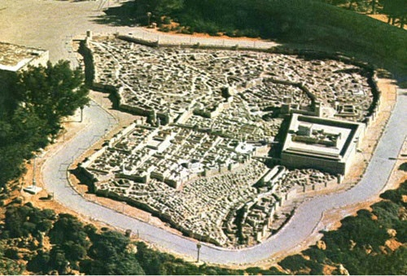
2 SAMUEL
Calvary
Mt. Moriah
The Temple
City of David

